Slide 1
RAG: Using your Data With LLMS
Sanket Sudake

Slide 2

About Me @sanketsudake
Principal Engineer, InfraCloud
Interest Areas: AI, Cloud/Containers, Distributed Systems
Past: Started as Kernel Engineer
Worked as Go developer, Openstack developer, SRE
Maintainer Fission - Serverless
Recent AI projects
Slack/Zendesk Analysis with OpenAI
Source Code Repository Analysis with LLM Agent
Building Large Scale AI Cloud

Slide 3
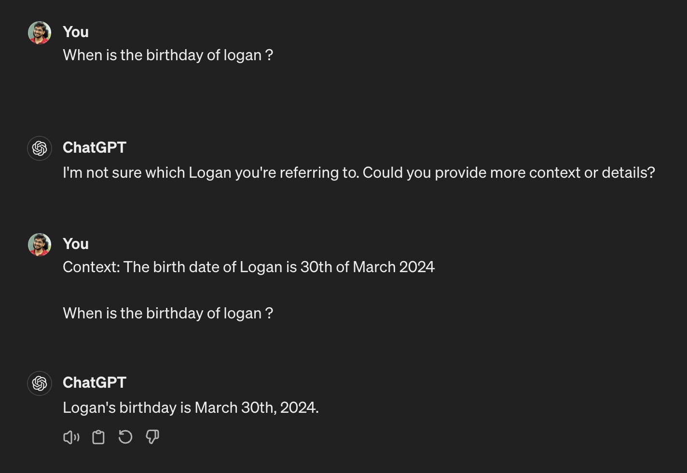

Slide 4
Recommended Learnings
Explained: The conspiracy to make AI seem harder than it is! By Gustav Söderström
Prompt Engineering
https://www.promptingguide.ai/
Generative AI For Begineers - Microsoft

Slide 5
Understanding Retrieval Augmented Generation

Slide 6
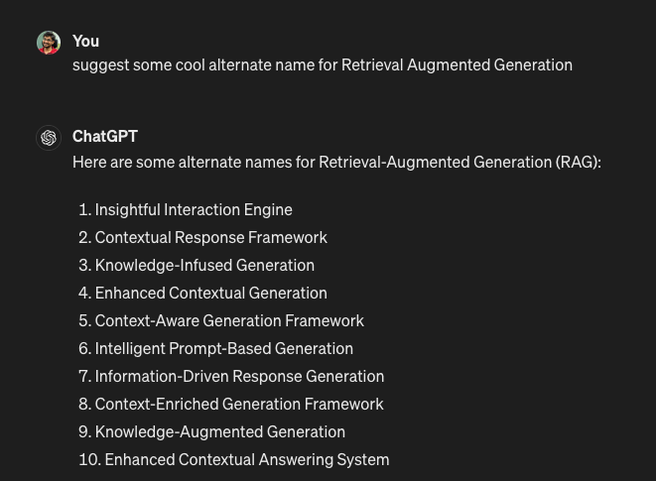
Why not
“We always planned to have a nicer sounding name, but when it came time to write the paper, no one had a better idea,” - Lewis, Lead Author

Slide 7
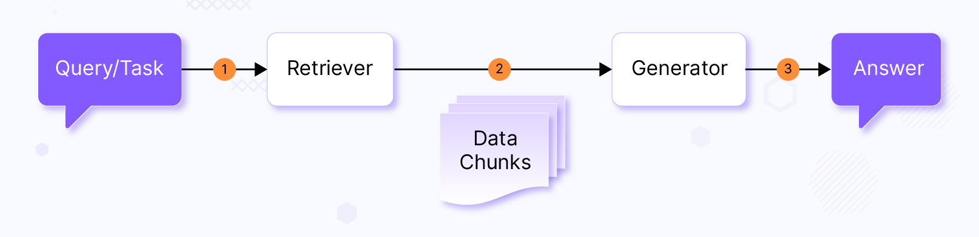
Understanding RAG
Retriever: Retrieves data needed for the user query
Generator: Feed data into LLM prompt and generates response
Notes:
https://www.infracloud.io/blogs/retrieval-augmented-generation-using-data-with-llms/

Slide 8
Naive RAG
Document Processing + Ingestion
Retrieval + Generation
Chunk
Vector Database
Chunk
Documents
Data Chunks
LLM
Chunk
Chunk
Data
Embeddings
Retrieval
Generation
Notes:
https://jalammar.github.io/illustrated-word2vec/

Slide 9
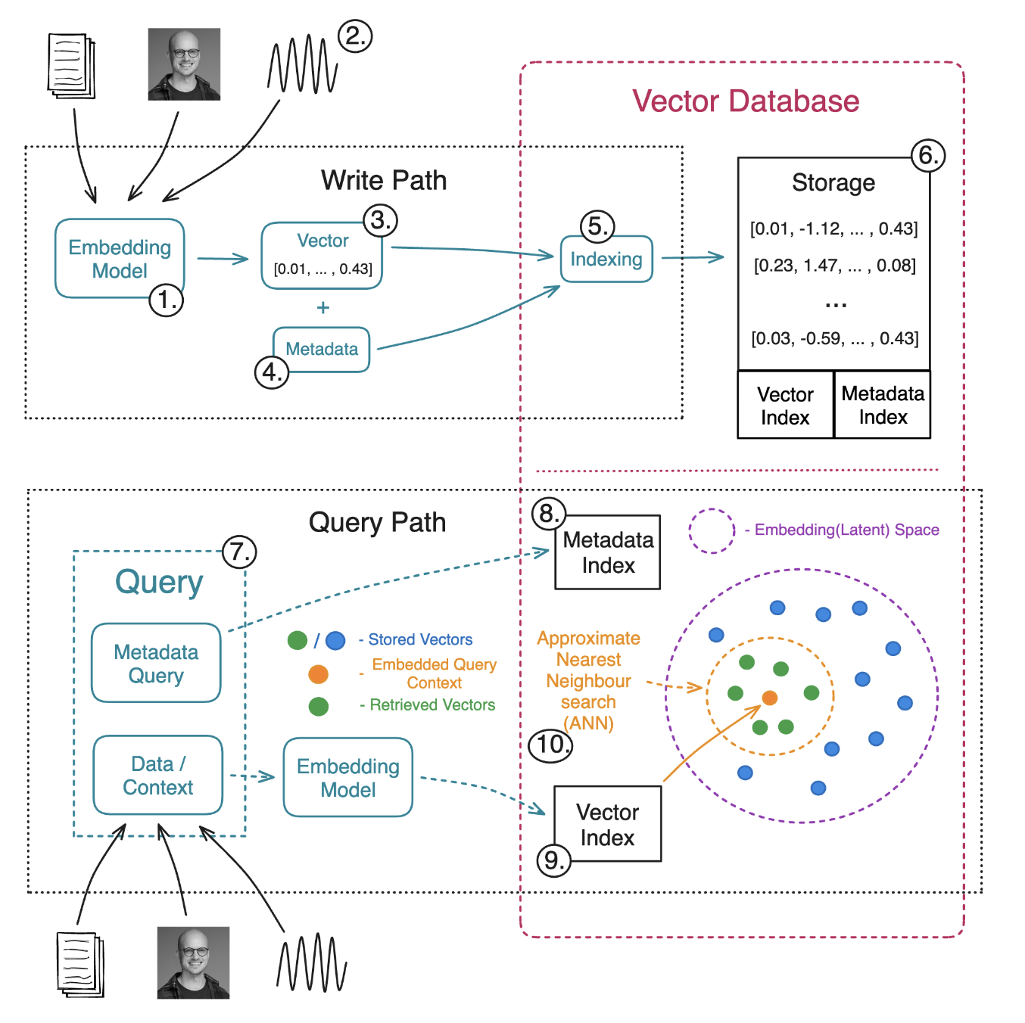
Ref: swirlai.com
Vector Database

Slide 10
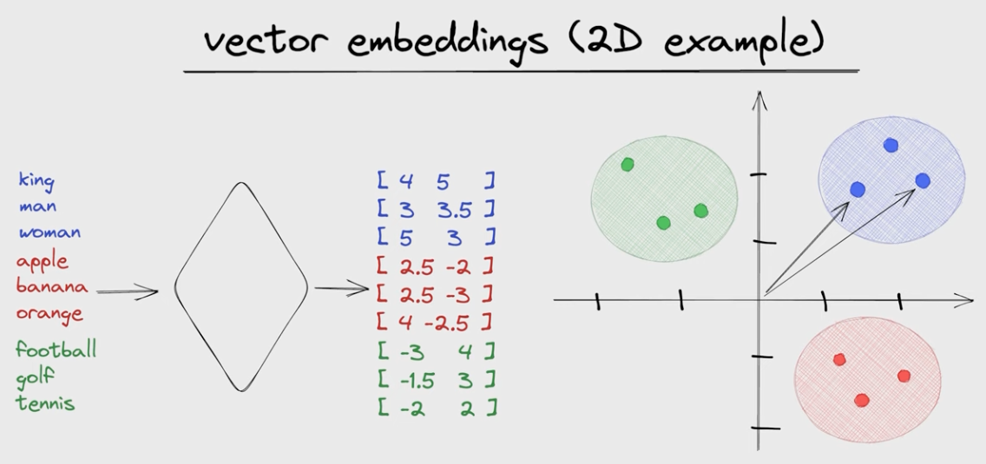
Ref: jkfran.com
Embeddings

Slide 11
SkillScount - Demo App

Slide 12
“Team, as of today, when we are looking for a specific skills for a customer from our talent, we mostly scan through updated resumes or try to match based on our past memories, if a person has certain skillset. This is not very efficient.
We can explore, if we can leverage LLM to help us query our resume dataset better.”

Slide 13
Sample prompts
“Show me candidate skilled in {skill}”
“Show me candidates with {certification name} certification”
“Find resume with {x-y} years of experience”
“What are the skills of {candidate} ?”
“How much experience does {candidate} have?”

Slide 14
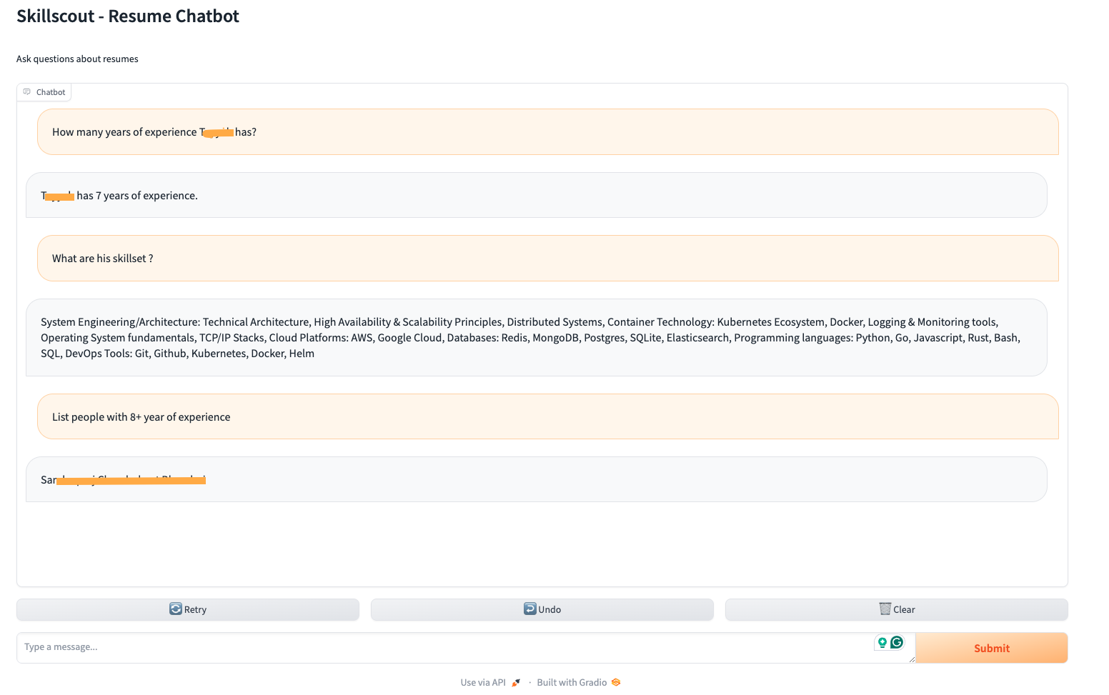
Demo

Slide 15
Packages
Langchain
Pypdf
OpenAI Embeddings
OpenAI GPT 3 Turbo
FAISS Vector Store

Slide 16
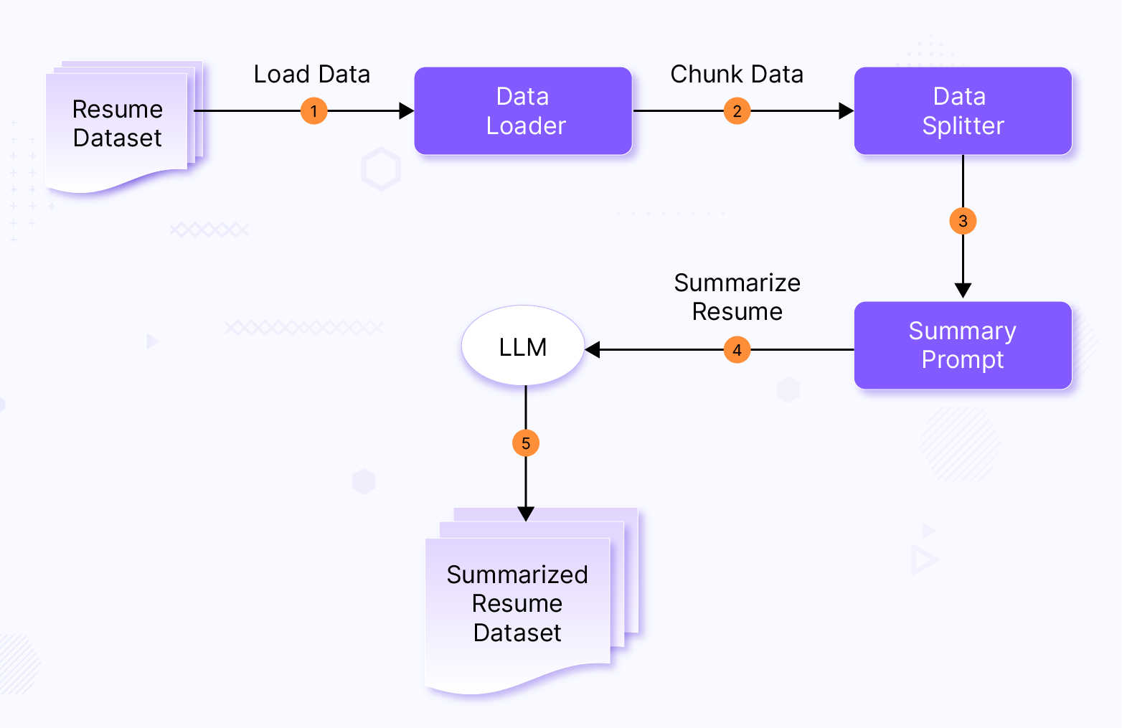
Document Processing Pipeline

Slide 17
Please extract the following data from the resume text provided in
triple quotes below and provide them only in format specified:
Name of the candidate:
Professional Summary:
Total years of experience:
Skills (comma separated):
Companies worked for (comma separated):
Education:
Certifications (comma separated):
When extracting the candidate’s total years of experience if available
in the resume text or calculate the total years of experience based on
the dates provided in the resume text.
If you are calculating then assume current month and year as Jan 2024.
Resume Text:
{text}
Summary Prompt

Slide 18
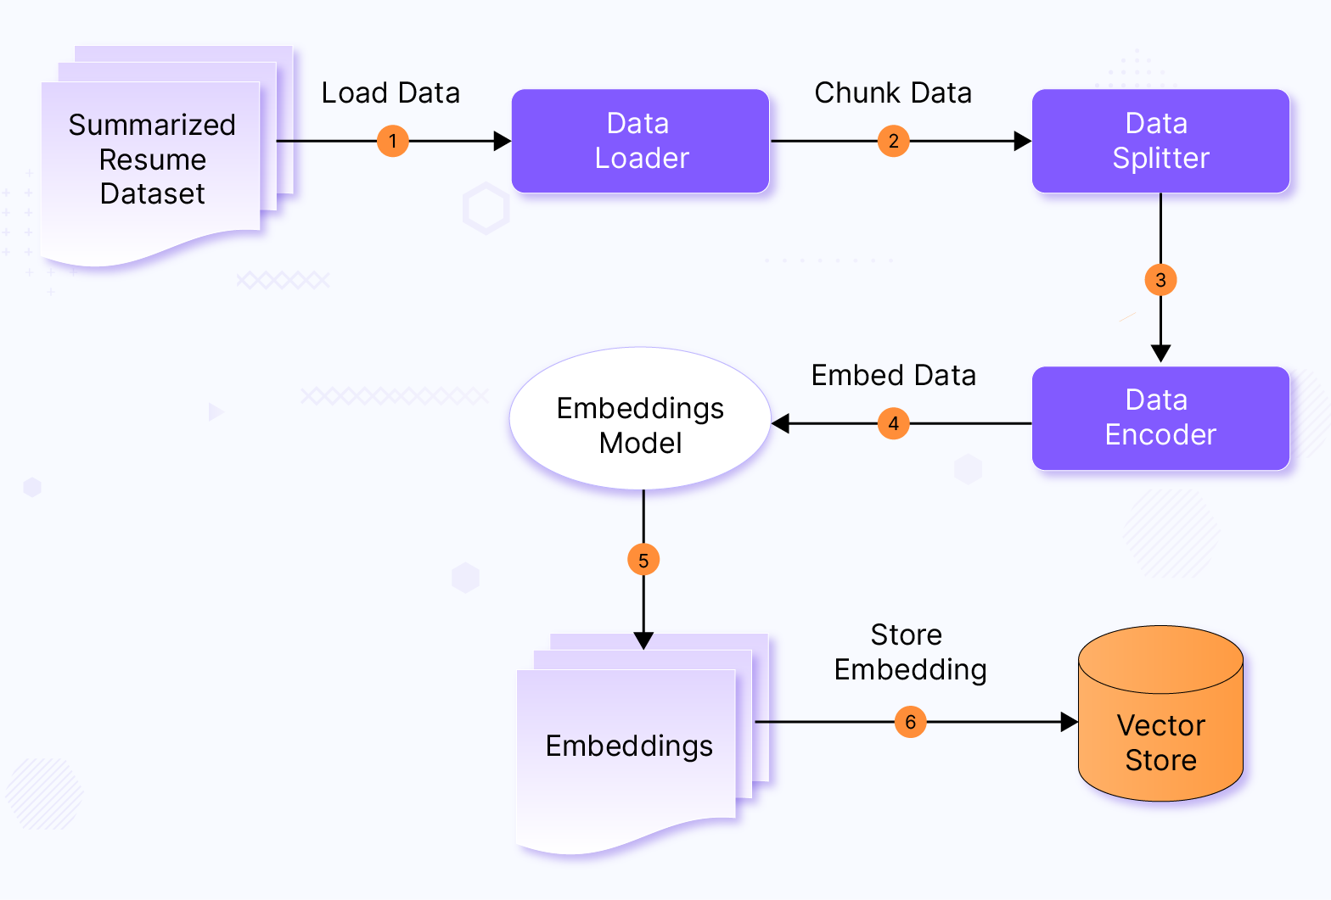
Vector Store Ingestion Pipeline

Slide 19
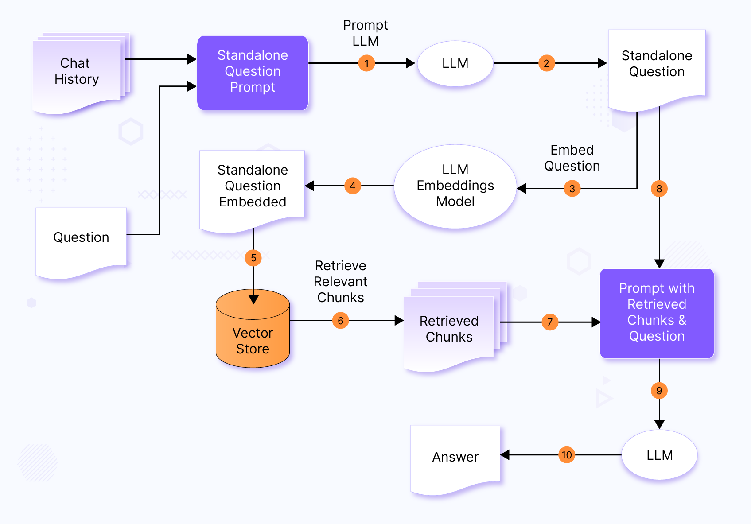
Vector Store Ingestion Pipeline

Slide 20
Chat History
Based on chat history and query from a user, we first check if we should reformat the question and reduce its dependency on the chat history.
Let’s say we have two questions,
Query 1: What skills does John Doe have?
Query 2: What’s his total years of experience?
Now in Query 2, “his” is a possessive pronoun which refers to John Doe. We may rewrite Query 2 as “What’s John Doe’s total years of experience?”

Slide 21
Chat History:
{chat_history}
Question: {question}
Given a chat history and the latest user question which might
reference context in the chat history, formulate a standalone question
which can be understood without the chat history.
Do NOT answer the question, just reformulate it if needed and
otherwise return it as is.
Reconstruct Question

Slide 22
Context has resume data of candidates.
Answer the question only based on the following context.
If you don't know the answer, just say that you don't know.
Be concise.
Context: {context}
Question: {question}
Answer:
Query After Restructuring

Slide 23
RAG for Production

Slide 24
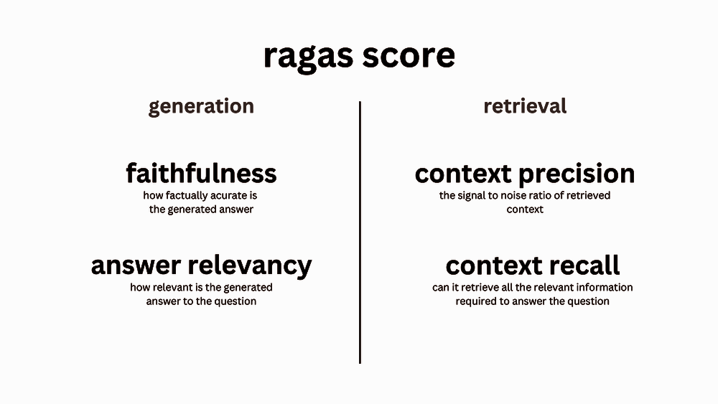
Evaluating RAG
Reference: ragas.io

Slide 25
Challenges with Naive RAG
Bad Retrieval
Low Precision: Not all chunks in retrieved set are relevant
Hallucination + Lost in the Middle Problems
Low Recall: Now all relevant chunks are retrieved.
Lacks enough context for LLM to synthesize an answer
Outdated information: The data is redundant or out of date.
Bad Response Generation
Hallucination: Model makes up an answer that isn’t in the context.
Irrelevance: Model makes up an answer that doesn’t answer the question.
Toxicity/Bias: Model makes up an answer that’s harmful/offensive.

Slide 26
What do we do ?
Data: Can we store additional information beyond raw text chunks?
Embeddings: Can we optimize our embedding representations?
Retrieval: Can we do better than top-k embedding lookup?
Synthesis: Can we use LLMs for more than generation?
Chunk
Chunk
Vector Database
Documents
Data Chunks
LLM
Chunk
Data Resumes
Chunk
Synthesis
Embeddings
Retrieval

Slide 27
Expectations from Solution
Accuracy expectations: The level of accuracy required for the task at hand will influence the design and implementation of the RAG system.
Hallucination prevention: Ensuring the generated responses are accurate and relevant, without introducing false or misleading information, is crucial.
Dataset scale and nature: The dataset’s size and nature will impact the retrieval process and the overall performance of the RAG system.

Slide 28
Quality of Retrieved Chunks
Relevance: Chunks should be highly relevant to the query or context, ensuring that generated responses are on-topic and useful.
Diversity: Chunks should be diverse, avoiding redundancy and providing a broad range of information.
Contextuality: Chunks should be contextual, considering the conversation history for coherent responses.
Accuracy: Ensure retrieved information is accurate and factually correct to prevent incorrect distribution of facts across chunks.
Ranking: The order of retrieved chunks matters; re-ranking steps post-retrieval and incorporating user feedback improves relevance.

Slide 29
Optimizing RAG pipeline
Generating more better and relevant responses
Privacy and security: Ensure personal and sensitive information is not revealed.
Data management policies: Adhere to data management policies, including forgetting past data and injecting fresh data as per requirements.
Scalability, reliability, and cost-efficiency: Ensure the RAG solution is scalable, reliable, and cost-efficient for enterprise usage.

Slide 30
Comparing RAG and LLM Fine Tuning
LLM Fine-Tuning | RAG
Alters LLM | No alterations to LLM
Less adaptability/flexibility | More adaptability/flexibility
Tightly coupled with LLM | There is no tight dependency on LLM, the model can be swapped
Data set size constraints overall considering the cost of fine-tuning | No data restrictions as such, cost marginally increases with dataset size increase

Slide 31
References
Retrieval-Augmented Generation for Knowledge-Intensive NLP Tasks
Dense Passage Retrieval for Open-Domain Question Answering
LangChain
Ragas

Slide 32
Questions ? Let my LLM answer it
:-)

